Slide 1
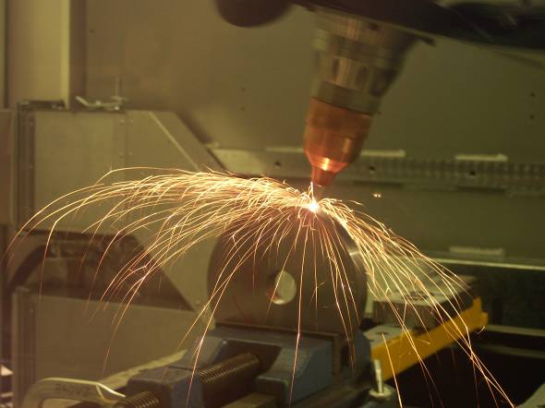
Product Realization Technology
IC141
Even Semester February-June 2014
Dr. Mohammad Talha
Asst. Professor
School of Engineering
Indian Institute of Technology Mandi
H.P., INDIA, 175 001
talha@iitmandi.ac.in

Slide 2
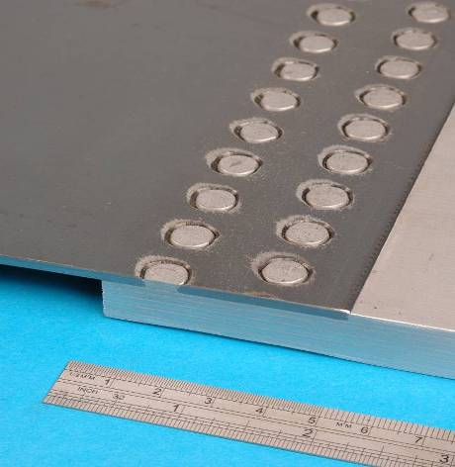
Lecture #1
Learning objectives
Course content and overview
Examination requirements

Slide 3
Learning objectives
• Knowledge and understanding the properties of metals, polymers, composites and ceramics.
Knowledge and understanding of the most important Product Realization Technology (Manufacturing Processes).
Understanding the relationships among material properties and manufacturing process parameters.
Knowledge, understanding and skills to make quantitative analyses of manufacturing processes.

Slide 4
Content of the course
Introduction:
Engineering materials, their manufacturability and application
• Machining:
Lathe, drilling, milling and grinding machines and their operations.
Casting:
Pattern materials, pattern types, allowances, molding sand, composition and properties, cores, casting defects and their remedies, plastic parts molding
Joining:
Welding fundamentals, types of welded joints, types of welding processes, gas welding process, manual metal welding, welding defects and remedies, Soldering and brazing, their applications in electronics industry

Slide 5
Content of the course
Forming:
Engineering materials, their manufacturability and application
• Advanced Manufacturing Processes:
Lathe, drilling, milling and grinding machines and their operations.

Slide 6
Suggested Books
Materials and Processes in Manufacturing, E. Paul DeGarmo, JT. Black, R. A. Kohser, Prentice Hall of India Pvt. Ltd.- New Delhi (ISBN 81-203-1243-0) 1997
Manufacturing Engineering and Technology, S. Kalpakjain, S.R. Schmid, Pearson Education, New Delhi, (ISBN 81-7808-157-1) 2000
Fundamentals of Modern Manufacturing, Mikell P. Grover, John Willey and Sons Inc (ISBN 0-471-40051-3) 2002
Processes and Materials of Manufacturing, R.A. Lindberg, Prentico Hall India Ltd. (ISBN 81-203-0663-5) 1990
Manufacturing Technology (Vol 1 and 2), P.N. Rao, Tata McGraw Hill New Delhi (ISBN 0-07-008798-9) 2009

Slide 7
Examination Requirements
Final marks:
Theory
- 25% Quizzes
- 10% Assignments/Attendance/Class discipline
- 40% End term examination
Practical
- 15% Job work
- 10% Documentation
Expected knowledge and skills:
You must be able to apply the knowledge about materials and manufacturing operationally

Slide 8
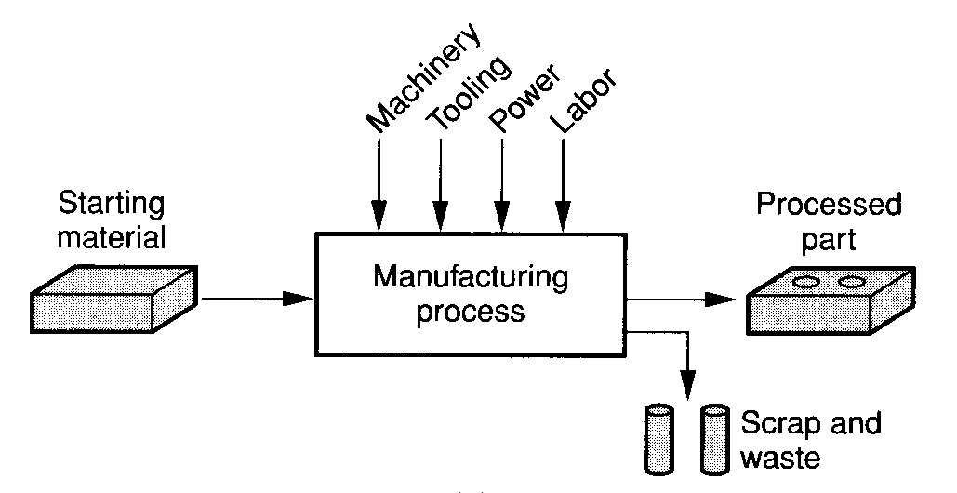
Product Realization Technology ?????
Representation of ‘manufacturing’ in a technological way

Slide 9
PRODUCT REALIZATION
Product design
Process planning
Operation programming
Verification
Scheduling
Execution
Process,
machine
knowledge
Scheduling
knowledge

Slide 10
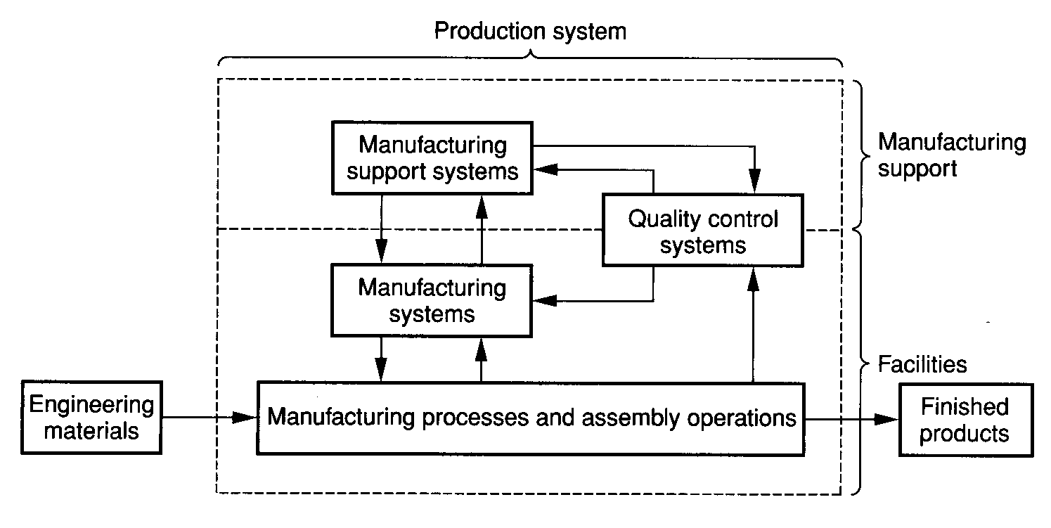
Manufacturing System

Slide 11
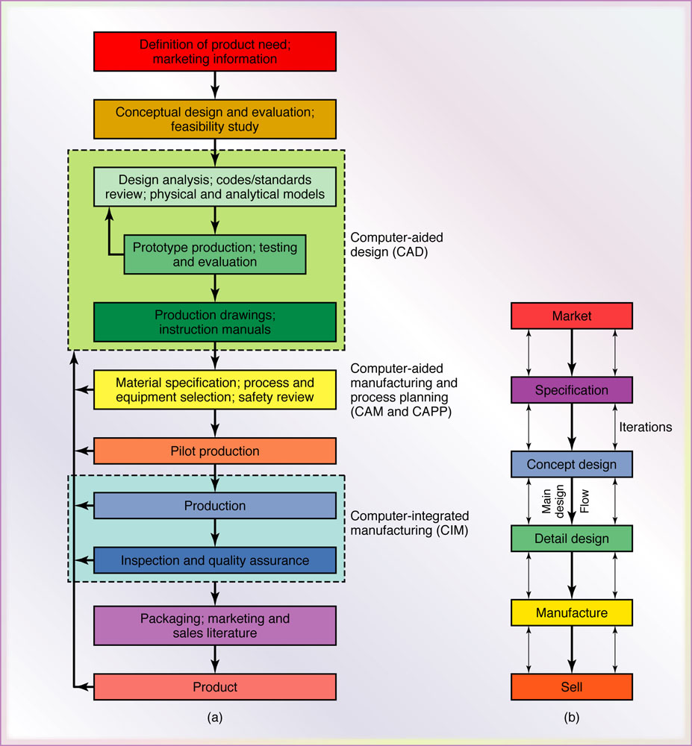
Product Design Process

Slide 12

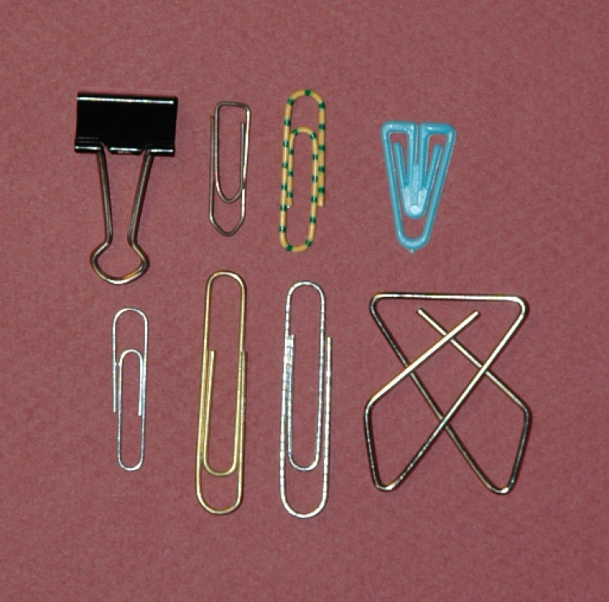
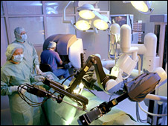

Engineering Materials

Slide 13
Engineering Materials

Slide 14
Engineering Materials
Materials
Metals
Plastics
Ferrous
Non-ferrous
Thermoplastics
Thermosets
Elastomers
Steel
Stainless steel
Die & tool steel
Cast iron
Aluminum
Copper
Zinc
Titanium
Tungsten
Acrylic
Nylon
ABS
Polyethylene
Polycarbonate
PVC
Phenolic
Polymide
Epoxies
Polyester
Rubber
Polyurethane
Silicone

Slide 15
Engineering Materials
Materials
Ceramics
Glass
Composites
Reinforced plastics
Metal-Matrix
Ceramic-Matrix
Laminates
Carbides
Nitrides
Graphite
Diamond
Glasses
Glass ceramics

Slide 16
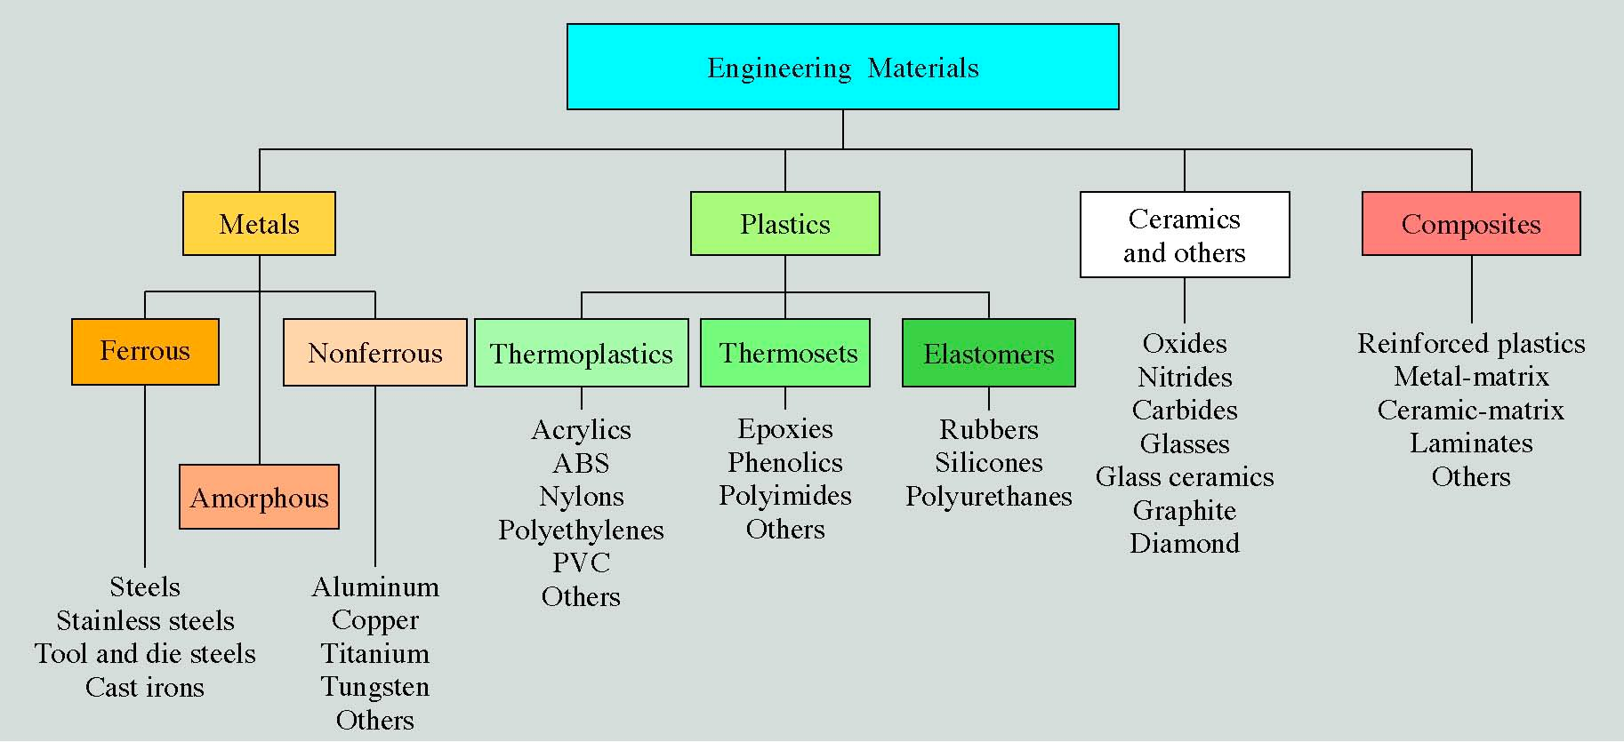

Slide 17
Metals
Metal is a chemical element that is a good conductor of both electricity and heat and forms cations and ionic bonds with non-metals
Distinguishing features
  Atoms arranged in a regular repeating structure
  Relatively good strength
  Dense
  Malleable or ductile: high plasticity
  Resistant to fracture: tough
  Excellent conductors of electricity and heat
  Opaque to visible light
  Shiny appearance
Atoms are situated in a repeating array
over large atomic distances.

Slide 18
Metals (Continued)
Machined easily, and are usually long-lasting materials.
Do not react easily with other elements, however, metals such as Fe and Al do form compounds readily (such as ores) so they must be processed to extract base metals.
Main drawbacks is that metals do react with chemicals in the environment, such as iron-oxide (rust).
Many metals do not have high melting points, making them useless for many applications.

Slide 19
Metals(Continued)
Applications
  Electrical wiring
  Structures: buildings, bridges, etc.
  Automobiles: body, chassis, springs, engine block, etc.
  Airplanes: engine components, fuselage, landing gear assembly, etc.
  Trains: rails, engine components, body, wheels
  Machine tools: drill bits, hammers, screwdrivers, saw blades, etc.
  Shape memory materials: eye glasses
  Magnets
Examples
  Pure metal elements (Cu, Fe, Zn, Ag, etc.)
  Alloys (Cu-Sn=bronze, Cu-Zn=brass, Fe-C=steel, Pb-Sn=solder, NiTinol)
  Intermetallic compounds (e.g. Ni₃Al)
Notes:
12/25/10
19

Slide 20
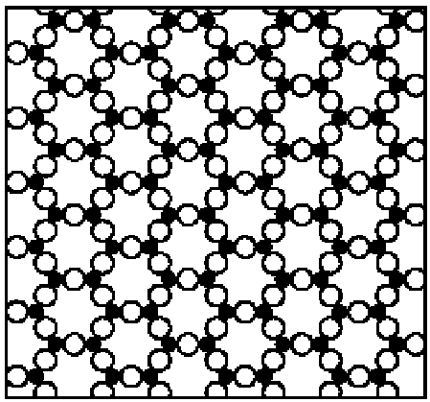
Ceramics
A ceramic is defined as a compound containing metalic (or semi- metallic) and non metalic elements bonded ionically.
Nonmetalic elements are oxygen, nitrogen, and carbon.
Available in the form of oxides, carbide and nitrides
Fig :Open circles represent nonmetallic atoms, solids represent metal atoms
Notes:
12/25/10
20

Slide 21
Ceramics(Continued)
Distinguishing features
  Composed of a mixture of metal and nonmetal atoms
  Lower density than most metals
  Stronger than metals
  Low resistance to fracture: low toughness or brittle
  Low ductility or malleability: low plasticity
  High melting point
  Poor conductors of electricity and heat
  Single crystals are transparent
  Except for glasses, atoms are regularly arranged
Where metals react readily with chemicals in the environment and have low application temperatures in many cases, ceramics do not suffer from these drawbacks.
Ceramics have high-resistance to environment as they are essentially metals that have already reacted with the environment, e.g. Alumina (Al₂O₃) and Silica (SiO₂, Quartz).
Ceramics are heat resistant. Ceramics form both in crystalline and non-crystalline phases because they can be cooled rapildy from the molten state to form glassy materials.
Notes:
12/25/10
21

Slide 22
Ceramics(Continued)
Applications
  Electrical insulators
  Abrasives
  Thermal insulation and coatings
  Windows, television screens, optical fibers (glass)
  Corrosion resistant applications
  Electrical devices: capacitors, varistors, transducers, etc.
  Highways and roads (concrete)
  Biocompatible coatings (fusion to bone)
  Self-lubricating bearings
  Magnetic materials (audio/video tapes, hard disks, etc.)
  Optical wave guides
Examples
  Simple oxides (SiO₂, Al₂O₃, Fe₂O₃, MgO)
  Mixed-metal oxides (SrTiO₃, MgAl₂O₄, YBa₂Cu₃O_{7-x}, having vacancy defects.)
  Nitrides (Si₃N₄, AlN, GaN, BN, and TiN, which are used for hard coatings.)
Notes:
12/25/10
22

Slide 23
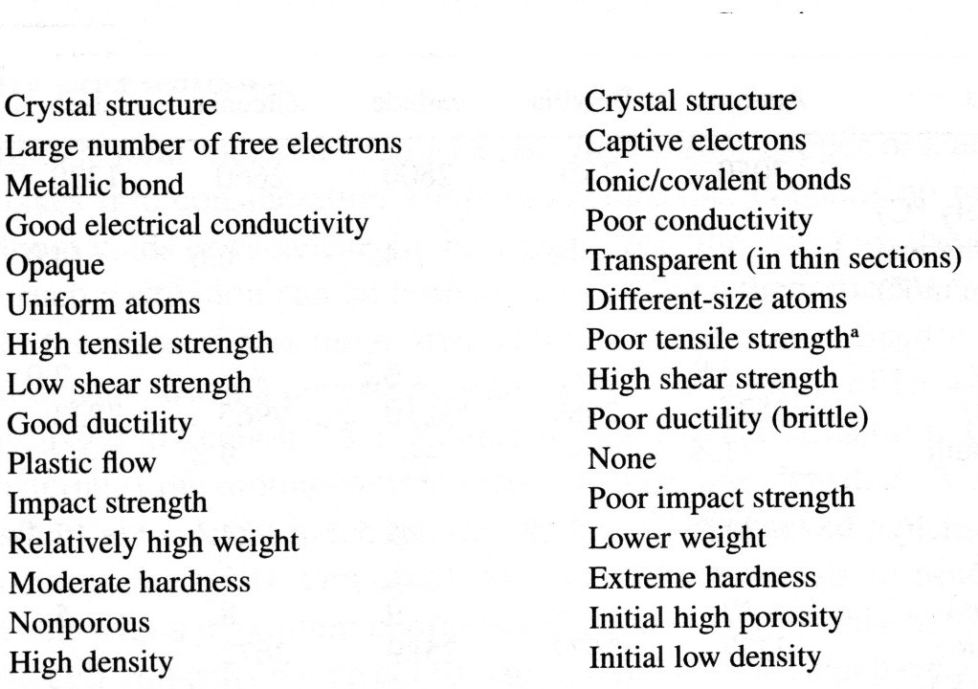
Comparison Metals Vs Ceramics
Metals
Ceramics
Notes:
12/25/10
23

Slide 24
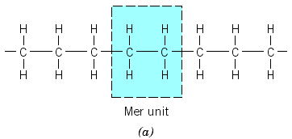
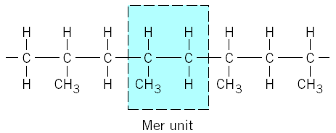
Polymer
A polymer is a compound formed of repeating structural units called mers, whose atoms share electrons to form very large molecules.
Polymer usually consists of carbon plus one or more elements such as hydrogen, nitrogen, an chlorine
Polyethylene: (the mer unit is C2H4)
Polypropylene: (the mer unit is now C3H6)
Notes:
12/25/10
24

Slide 25
Polymer
Distinguishing features
  Composed primarily of C and H (hydrocarbons)
  Low melting temperature.
  Most are poor conductors of electricity and heat.
  Many have high plasticity.
  A few have good elasticity.
  Some are transparent, some are opaque
Polymers are attractive because they are usually lightweight and inexpensive to make, and usually very easy to process, either in molds, as sheets, or as coatings.
Most are very resistant to the environment.
They are poor conductors of heat and electricity, and tend to be easy to bend, which makes them very useful as insulation for electrical wires. They are also
Notes:
12/25/10
25

Slide 26
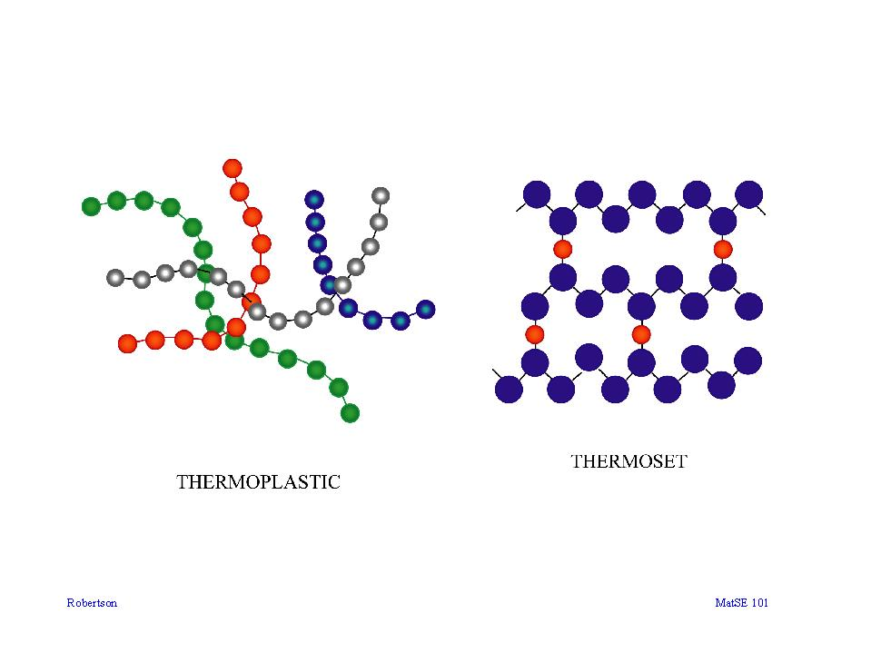

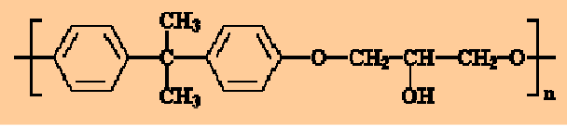
Polymer
Polymers are divided into three categories
1) Thermoplastic polymers 2)Thermosetting polymers 3) Elastomers
Thermosetting are cross-linked polymers that form 3-D networks,
hence are strong and rigid.
Thermoplastics are long-chain polymers that slide easily past one
another when heated, hence, they tend to be easy to form, bend, and break
Elastomers are polymers that exhibit significant elastic behavior .
PVC
26
Notes:
12/25/10
26

Slide 27
Polymer(Continued)
Applications and Examples
  Adhesives and glues
  Containers
  Moldable products (computer casings, telephone handsets, disposable razors)
  Clothing and upholstery material (vinyls, polyesters, nylon)
  Water-resistant coatings (latex)
  Biodegradable products (corn-starch packing “peanuts”)
  Biomaterials (organic/inorganic intefaces)
  Liquid crystals
  Low-friction materials (teflon)
  Synthetic oils and greases
  Gaskets and O-rings (rubber)
  Soaps and surfactants
Notes:
12/25/10
27

Slide 28
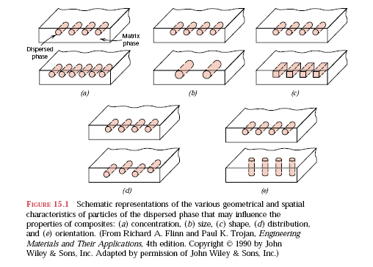
Composite
A composite is a multiphase material that is artificially produced.
The phases are chemically dissimilar and separated by a distinct
interface.
Many of the composite materials are composed of two phases:
one is matrix and other is dispersed phase (reinforcement)
Notes:
12/25/10
28

Slide 29
Types of Composites
Matrix phase/Reinforcement Phase
Metal
Ceramic
Polymer
Metal
Powder metallurgy parts – combining immiscible metals
Cermets (ceramic-metal composite)
Brake pads
Ceramic
Cermets, TiC, TiCN
Cemented carbides – used in tools
Fiber-reinforced metals
SiC reinforced Al2O3
Tool materials
Fiberglass
Polymer
Kevlar fibers in an epoxy matrix
Elemental (Carbon, Boron, etc.)
Fiber reinforced metals
Auto parts
aerospace
Rubber with carbon (tires)
Boron, Carbon reinforced plastics
MMC’s CMC’s PMC’s
Metal Matrix Composites Ceramic Matrix Comp’s. Polymer Matrix Comp’s
Notes:
12/25/10
29

Slide 30
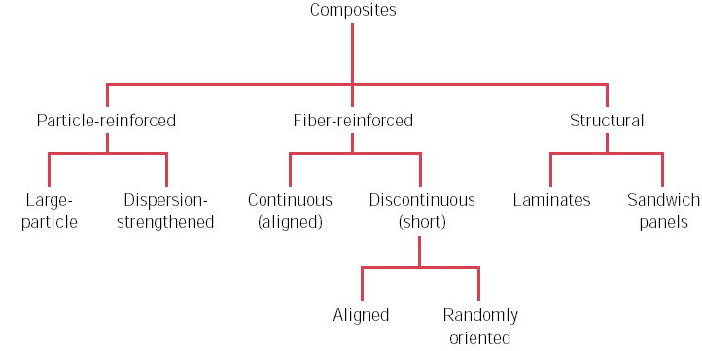
Types of Composites
Notes:
12/25/10
30

Slide 31
Composite(Continued)
Distinguishing features
  Composed of two or more different materials (e.g., metal/ceramic, polymer/polymer, etc.)
  Properties depend on amount and distribution of each type of material.
  Collective properties more desirable than possible with any individual material.
Applications and Examples
  Sports equipment (golf club shafts, tennis rackets, bicycle frames)
  Aerospace materials
  Thermal insulation
  Concrete
  "Smart" materials (sensing and responding)
  Brake materials
Examples
  Fiberglass (glass fibers in a polymer)
  Space shuttle heat shields (interwoven ceramic fibers)
  Paints (ceramic particles in latex)
  Tank armor (ceramic particles in metal)
Notes:
12/25/10
31

Slide 32
SHAPE MEMORY MATERIALS
DEFINITION:
Shape Memory Materials (SMM) are those Materials which, After being Deformed PLASTICALLY (i.e. PERMANENTLY) at the Room Temperature into Various Shapes, Return to their Original Shapes upon Heating
EXAMPLES:
  Typical Shape Memory Alloys are
  55% Ni-45%Ti
  Copper-Aluminum-Nickel
  Copper-Zinc-Aluminum
  Iron-Manganese-Silicon
Notes:
12/25/10
32

Slide 33
SHAPE MEMORY MATERIALS(Continued)
CHARACTERISTICS:
  SMM have Good Ductility, Good Corrosion Resistance, High Electrical Conductivity
  Behavior of SMM can Also be Reversible i.e. Shape can Switch Back and Forth upon Heating
APPLICATIONS: Can be Used
  To Generate Motion and/or Force in Temperature-Sensitive Actuators
  Eyeglass Frames, Connectors, Clamps, Fastener, and in Seals
Notes:
12/25/10
33

Slide 34
NANO-MATERIALS
DEFINITION:
Materials with Grains, Fibers, Films, and Composites having Particle Size of the Order of 1-100 nm
EXAMPLES: Any Combination of Chemical Elements
  Important Compositions are Carbides, Oxides, Nitrides, Metals and Alloys, Organic Polymers and Various Composites
ALTERNATIVE NAMES: Nano-Crystalline Materials, Nano-Structured Materials Nano-Phase Materials , Nano-Powders, Nano-WiresNano-Tubes, Nano-Films
Notes:
12/25/10
34

Slide 35
NANO-MATERIALS (Continued)
CHARACTERISTICS:
  Since Synthesis is Done at Atomic Level, their Purity and Homogeneity (99.9999 %), and Uniformity of their Microstructure is Highly Controlled → Their Mechanical, Physical, and Chemical Properties can be Precisely Controlled
  Properties such as Strength, Ductility, Hardness, Wear Resistance, Corrosion Resistance, that Frequently Superior to Traditional and Commercially Available Materials
  Unique Electrical, Magnetic, and Optical Properties
Notes:
12/25/10
35

Slide 36
NANO-MATERIALS
APPLICATIONS:
  Cutting Tools and Inserts (Made of Nano-Crystalline Carbides and Other Ceramics)
  Ductile and Machinable Nano-Phase Ceramics
  Powders for Powder Metallurgy Processing
  Next-Generation Computer Chips Using Nano-Crystalline Materials with High Purity, Better Thermal Conductivity and More Durable Interconnections
  Flat-Panel Displays for Laptop Computers (Made by Synthesizing Nano-Crystalline Phosphorous to Improve Resolution)
  Spark-Plug Electrodes
  Igniters for Rockets, Medical Implants
  High-Sensitivity Sensors
  Catalysts for Elimination of Pollutants
  High Power Magnets
  High Energy Density Batteries
Notes:
12/25/10
36

Slide 37
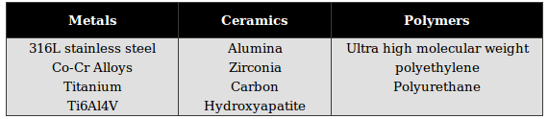
BIOMATERIAL
Defined as "any substances (other than a drug) or combination of substances synthetic or natural in origin, which can be used for any period of time, as a whole or as a part of a system which treats, augments, or replaces any tissue, organ or function of the body.
Theoretically, any material can be a biomaterial as long as it serves the stated medical and surgical purposes.
Example of Biomaterial

Slide 38
Some application of biomaterials
Application
Types of Materials
Skeletel system
Joint replacement(Hip, knee)
Bone plate
Bone cement
Artificial tendon and ligment
Dental implant
Cardiovascalar sysem
Blood vessel prosthesis
Heart valve
Catheter
Organs
Artificial heart
Skin repair template
Artificial kidney
Heart-lung machine
Senses
Cochlear replacement
Intraocular lens
Contact lens
Corneal bandage
Titanium , Stainless steel, PE
Stainless steel, Co-Cr alloy
PMMA
Hydroxylapatie Teflon, Dacron
Titanium, alumina, calcium phosphate
Dacron, Teflon, Polyurethane
Reprocessed tissue, Stainless steel, Carbon
Silicone rubber, teflon, polyurethane
Polyurethane
Silicone-collage composite
Cellulose, polyacrylonitrile
Silicone rubber
Platium electrodes
PMMA, Silicone rubber, hydrogel
Silicone-acrylate. Hydrogel
Collagen, hydrogel

Slide 39
Biomaterials
Polymeric biomaterials
Bioceramics
Metallic biomaterials
Biocomposite
Biologically based (derived) biomaterials

Slide 40
Biocompatibility
Biocompatibility: The ability of a material to perform with an appropriate host response in a specific application.
Host response: the reaction of a living system to the presence of a material

Slide 41
APPLICATION OF BIOMATERIAL
Orthopaedic Applications
Metallic materials are normally used for load bearing members such as pins and plates and femoral stems etc
Ceramics such as alumina and zirconia are used for wear applications in joint replacements.
Polymers such as ultra high molecular weight polyethylene are used as articulating surfaces against ceramic components in joint replacements
Dental Applications
Metallic biomaterials have been used as pins for anchoring tooth implants and as parts of orthodontic devices.
Ceramics have found uses as tooth implants including alumina and dental porcelains.
Polymers, have are also orthodontic devices such as plates and dentures

Slide 42
APPLICATION OF BIOMATERIAL(Continued)
Cardiovascular Applications
Many different biomaterials are used in cardiovascular applications depending on the specific application and the design. For instance, carbon in heart valves and polyurethanes for pace maker leads
Cosmetic Surgery
Materials such as silicones have been used in cosmetic surgery

Slide 43
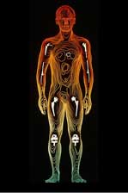
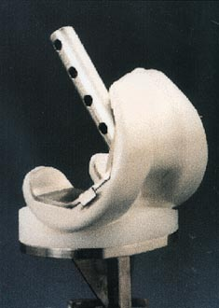
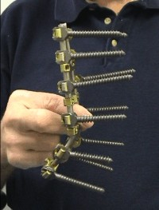
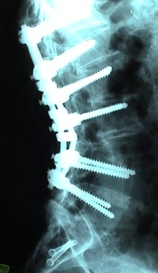
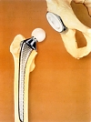
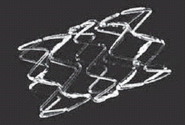
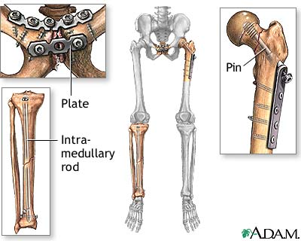
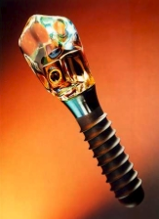
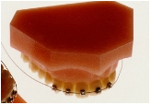
Metallic Biomaterials

Slide 44
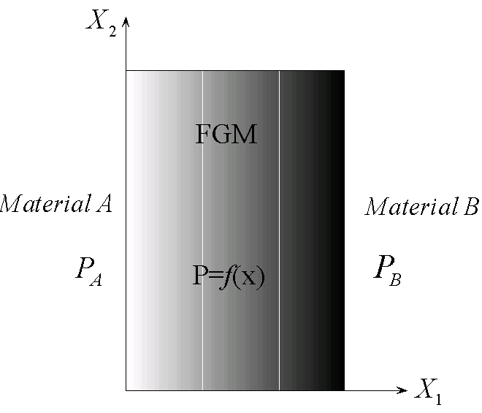
Functionally Graded Material (FGM)
Class of composite materials:
Composition and Microstructure varies locally during manufacturing
Mechanical and Thermal properties vary smoothly and continuously in a preferred direction(s)
The gradation in material properties
reduces:
  Stress concentrations
  Thermal stresses
  Residual stresses
  Strong interfacial bonding , etc.
(Variation between Material A & B)
Ref: P. Frank Pai, Highly flexible structures: Modelling, Computation, and Experimentation, AIAA Education Series

Slide 45
Power law behavior (FGM)
Gradation in material properties along a preferred direction:
Power law behavior
Ref: P. Frank Pai, Highly flexible structures: Modelling, Computation, and Experimentation, AIAA Education Series

Slide 46
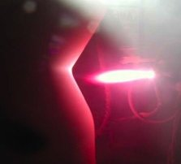
Applications of FGM
Advanced Air Craft and Aerospace Engines
Rocket heat shield
Plasma facing for fusion reactors
Engine Exhaust Liner
Car Engine Cylinders
Advanced Sports Equipment
Bio-Medical Engineering, etc.
A rocket combustion liner (left) being made by spraying material onto a model with a hot plasma (right)
Ref. http://www.nasa.gov/vision/earth/technologies/13apr_gradient.html

Slide 47
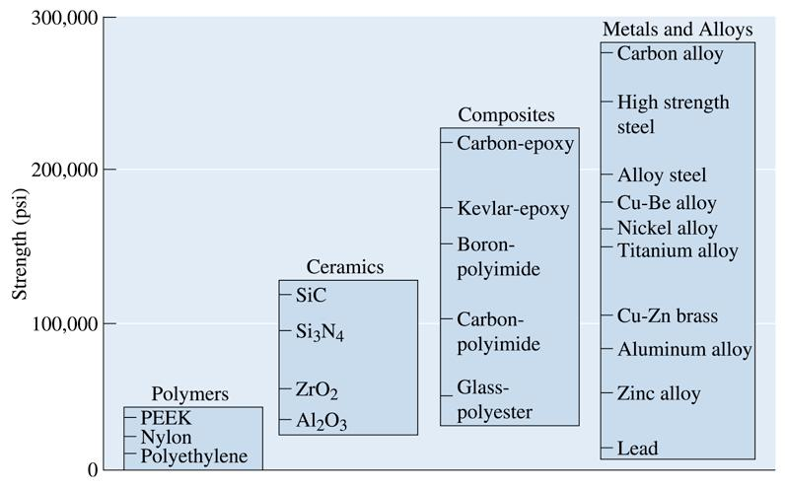
Representative strengths of various categories of materials
© 2003 Brooks/Cole Publishing / Thomson Learning™
Notes:
12/25/10
47

Slide 48
Comparision of materials
Metals: strong, ductile, high density, conductors, tough
Ceramics: strong, brittle, low density, insulators.
Polymers: weak, ductile, low density, insulators.
Semiconductors: weak, brittle, low density, semi-conductors.
Composites: strong, ductile, low density, conductors, insulators.
Studying materials
Materials Science
Relationships between
the structures and properties of the materials.
Materials Engineering
Designing the structure of a
material to produce a
predetermined set of properties
Notes:
12/25/10
48

Slide 49
Lecture presented herein are taken from different sources
like Internet, books, etc.
End of lecture #1

